Slide 1
Cursors

Slide 2
Objectives
At the end of this session, the participants will be able to:
Understand the concept of Cursors and its types & attributes
Use Cursors with LOOPS
Implement Parameterized Cursors
Use FOR UPDATE and WHERE CURRENT OF clauses with cursor
Understand the concept of REF Cursors and its types
Implement and use REF Cursors
Use REF Cursors with LOOPS

Slide 3
Agenda
Cursors and its types
Implicit Cursors
Explicit Cursors
Parameterized Cursors
WHERE CURRENT OF and FOR UPDATE clause
REF Cursors, its features and types
Strong Cursors
Weak Cursors
Using REF Cursors for Multiple Queries

Slide 4
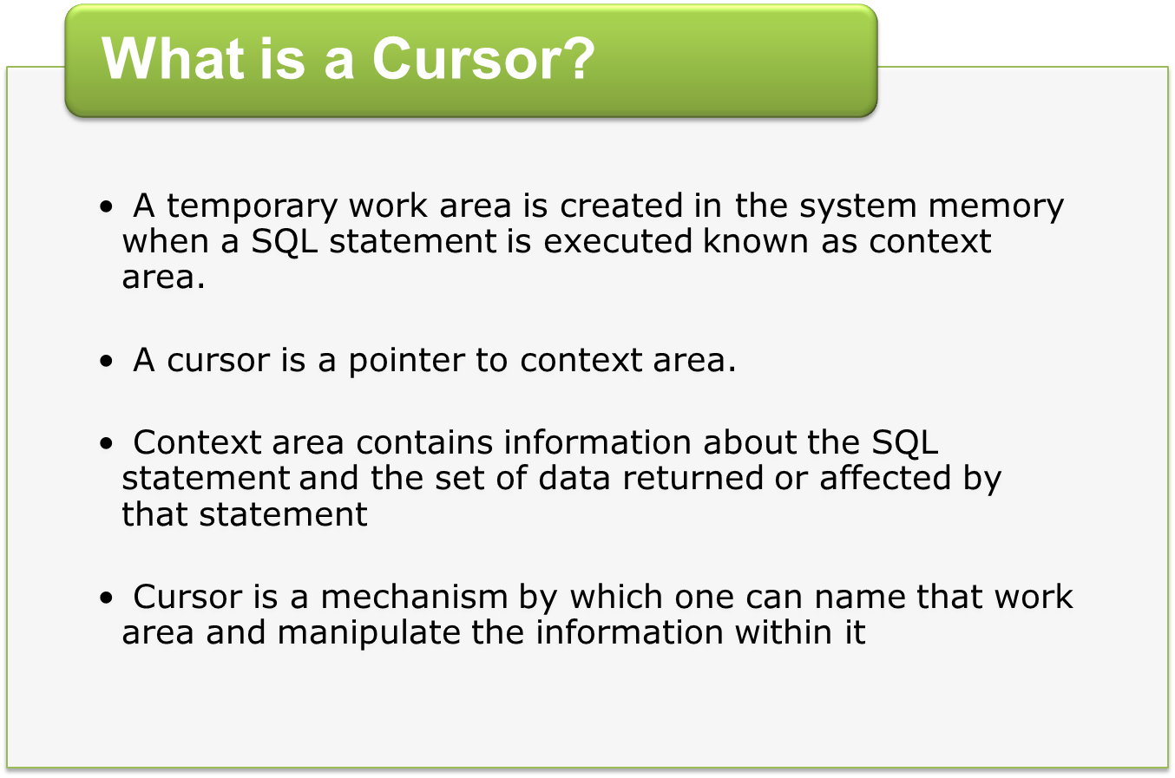
Notes:
When you execute a SQL statement from PL/SQL, the Oracle assigns a private work area for that statement known as context area.
This context area contains information about the SQL statement and the set of data returned or affected by that statement.
The set of rows the context area holds is called the active set.
The PL/SQL cursor is a mechanism by which you can name that context area and manipulate the information within it.
Cursors can be declared, opened, fetched and closed.
Basically this means declare a cursor name to use as a handle representing a query for obtaining items.
Open the cursor so that it can be used. Fetch the data required. Finally, when done close the cursor.

Slide 5
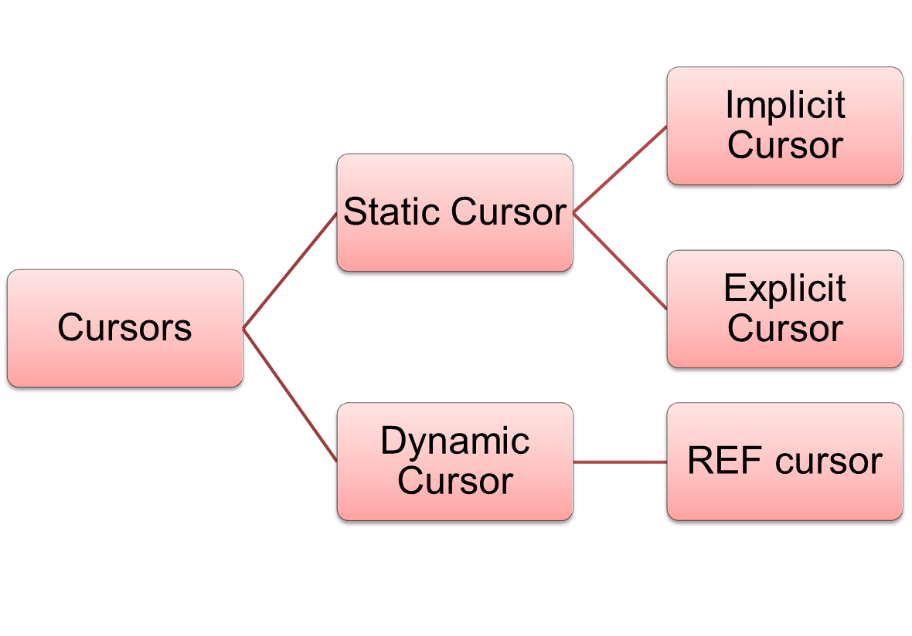
Types of Cursors
Notes:
Generally, there are two types of SQL that you can execute in PL/SQL: static and dynamic.
A Cursor is static if SQL statement is determined at compile time. The static cursor "hardcodes" a link between the cursor name and a SELECT statement. The static cursor itself comes in two flavors: implicit and explicit.
A Cursor is dynamic if SQL statement is constructed at runtime and then executed.
The bulk of this course is devoted to the of static cursors.

Slide 6
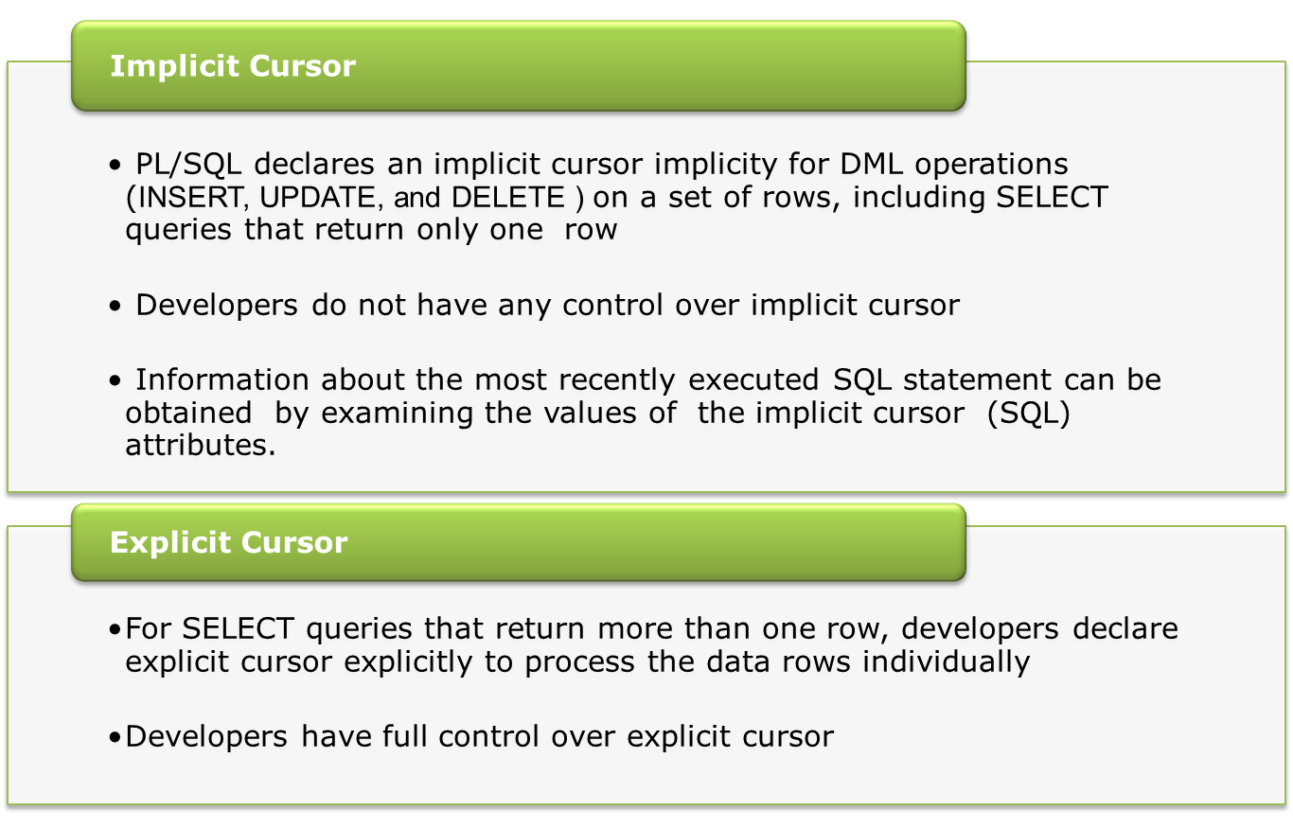
Static Cursors
Notes:
Implicit cursors
These are created by default when DML statements like, INSERT, UPDATE, and DELETE statements are executed. They are also created when a SELECT statement that returns just one row is executed.
PL/SQL declares and manages an implicit cursor every time you execute a SQL DML statement, such as an INSERT or a SELECT that returns a single row.
Explicit cursors
when you need to retrieve more than one row of data at a time through a SELECT statement, you must use an explicit cursor.
Even though the cursor stores multiple records, only one record can be processed at a time, which is called as current row. When you fetch a row the current row position moves to next row.
You can then use the cursor to fetch these rows one at a time. The set of rows returned by the query associated with an explicit cursor is called the active set or result set of the cursor. The row to which the explicit cursor points is called the current row of the result set.

Slide 7
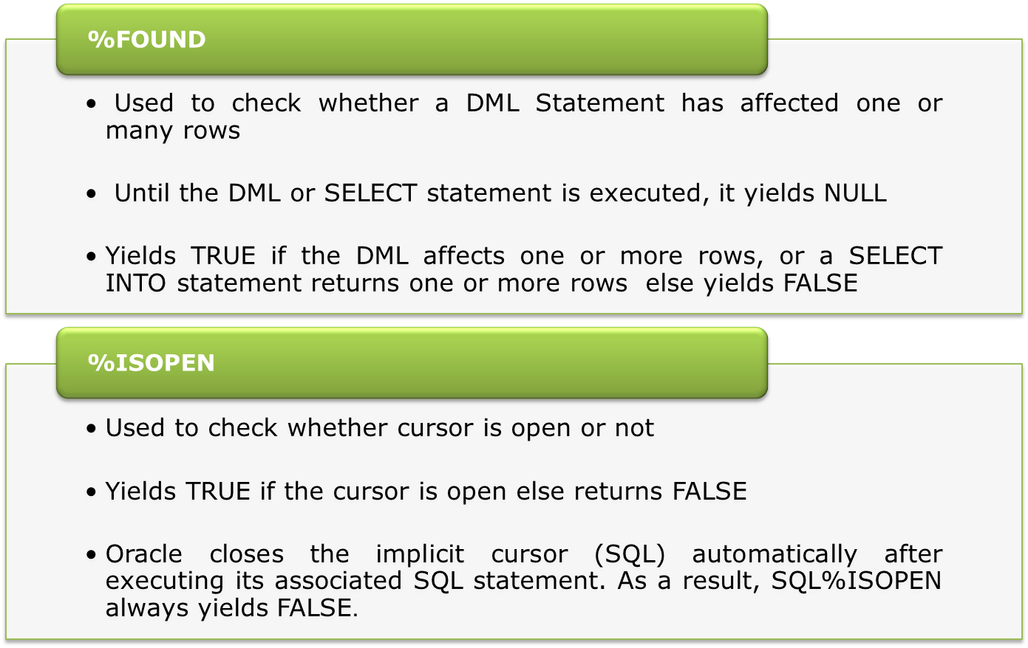
Cursor Attributes
Notes:
Guidelines for Using Attributes of Implicit Cursors
The following are considerations when using attributes of implicit cursors:
The values of the cursor attributes always refer to the most recently executed SQL statement, wherever that statement is. It might be in a different scope (for example, in a sub-block). To save an attribute value for later use, assign it to a local variable immediately. Doing other operations, such as procedure calls, might change the value of the variable before you can test it.
The %NOTFOUND attribute is not useful in combination with the SELECT INTO statement:
If a SELECT INTO statement fails to return a row, PL/SQL raises the predefined exception NO_DATA_FOUND immediately, interrupting the flow of control before you can check %NOTFOUND.
A SELECT INTO statement that calls a SQL aggregate function always returns a value or a null. After such a statement, the %NOTFOUND attribute is always FALSE, so checking it is unnecessary.

Slide 8
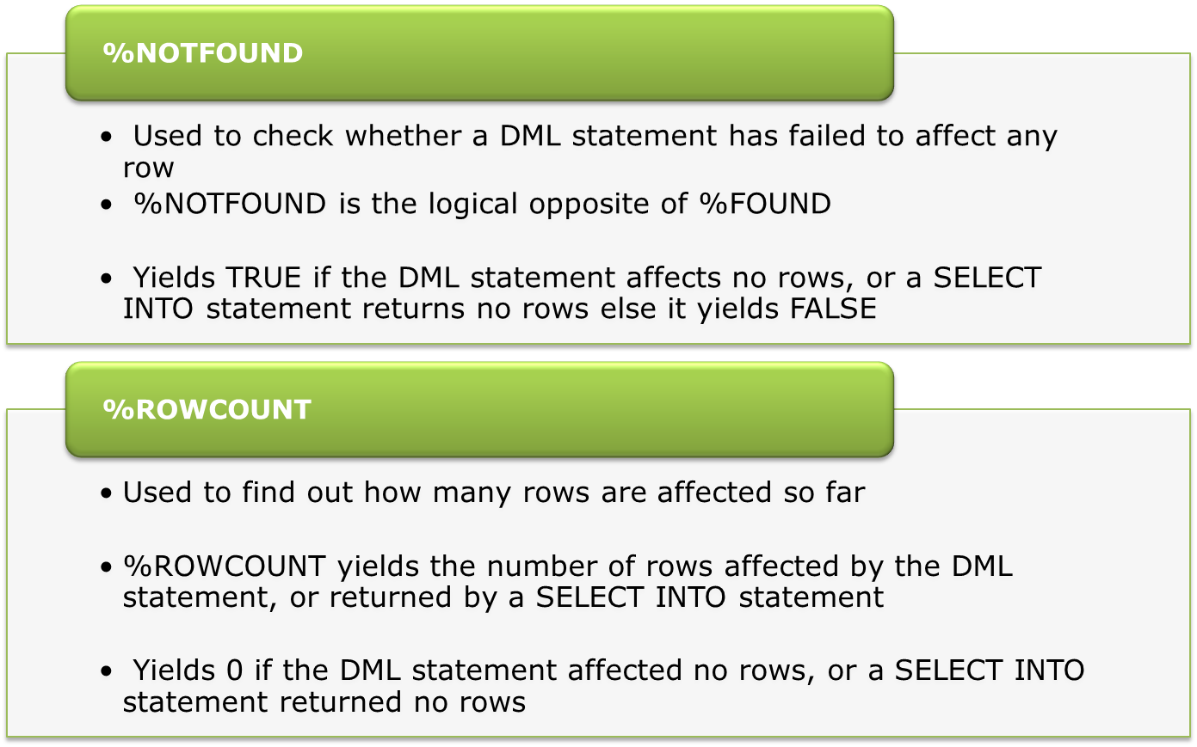
Cursor Attributes

Slide 9
Implicit Cursor: Using SQL%FOUND
Below pl/sql block delete row from customer table & displays whether delete was successful or not.
DECLARE
v_cust_id NUMBER(4) := &cust_id;
BEGIN
DELETE FROM customer WHERE cust_id = v_cust_id;
/* Making use of %FOUND to find out whether at least one row was affected by the DELETE statement */
IF SQL%FOUND THEN
DBMS_OUTPUT.PUT_LINE('Delete is successful');
ELSE
DBMS_OUTPUT.PUT_LINE('Delete is unsuccessful');
END IF;
END;

Slide 10
Explicit Cursor
Explicit cursors are programmer defined cursors for gaining more control over the context area.
An explicit cursor should be defined in the declaration section of the PL/SQL Block.
It is created on a SELECT Statement which returns more than one row.

Slide 11
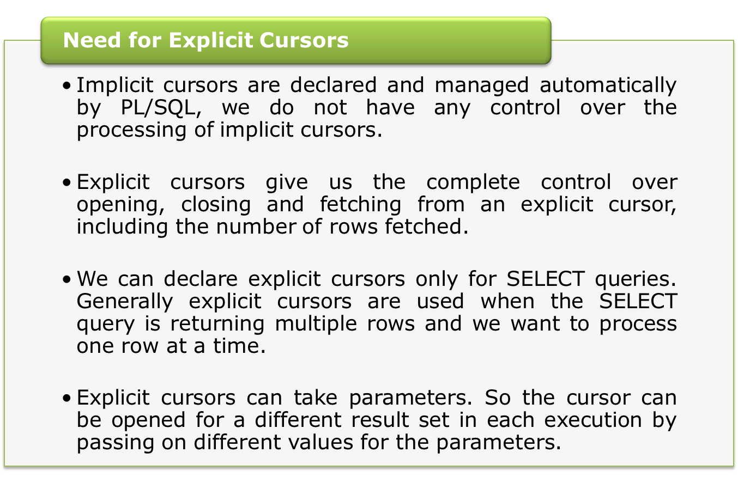
Explicit Cursors

Slide 12
Explicit Cursors
Are declared and named explicitly by the developer
Manipulated through specific statements in the block’s executable section for queries that return more the one row
Steps involved in processing Explicit Cursors:
NO
Empty ?
YES
DECLARE
OPEN
FETCH
CLOSE
Identify the active set
Load the current row into variables
Release the active set
Create a named SQL area
Test for existing rows
Return to FETCH if rows found
Notes:
explicit cursors give you the complete control over opening, closing and fetching from an explicit cursor, including the number of rows fetched.
To make use of the cursor attributes of explicit cursors, the keyword “SQL” is replaced by the cursor name
The four steps necessary for explicit cursor processing are as follows:
Declare the cursor
Open the cursor for a query
Fetch the current row of the cursor into appropriate variables, in an iterative manner
Close the cursor.

Slide 13
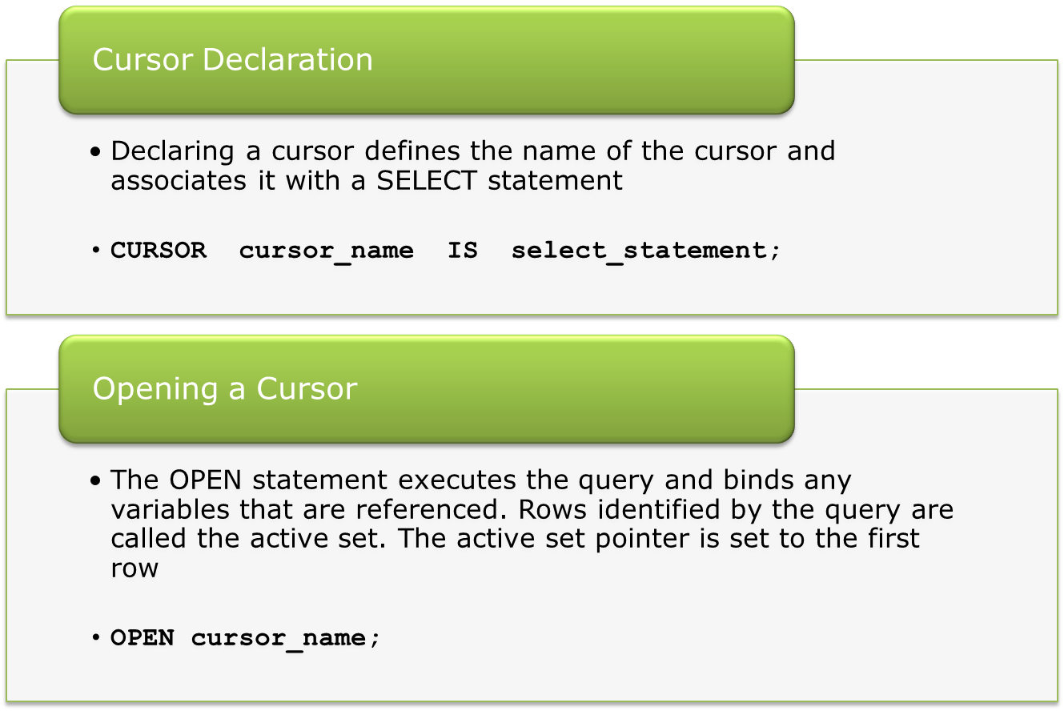
Process Explicit Cursors

Slide 14
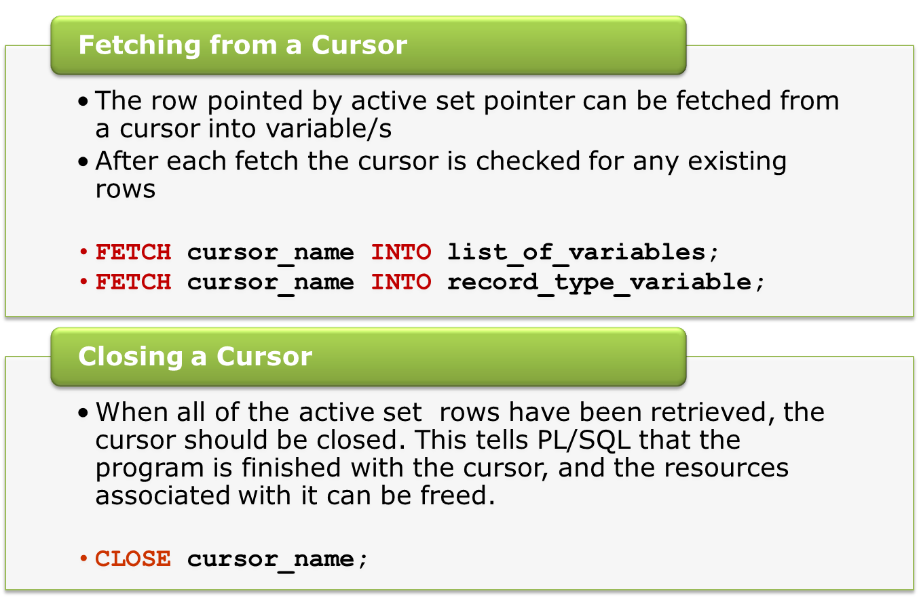
Process Explicit Cursors (Contd.)

Slide 15
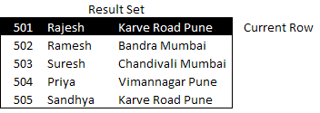
Process Explicit Cursors (Contd.)
This is how data is fetched from cursor in PL/SQL variable.
Database
Open
CURSOR
Fetch
PL/SQL
variable
Context Area
Notes:
This figure shows how cursor operations are used to fetch information from the database into your PL/SQL program.

Slide 16
Explicit Cursors: Accessing Limits
When does an error occur while processing an explicit cursor?
  When we try to open the cursor that is already open
  When we try to fetch from the cursor that is not opened
  When we try to fetch from the cursor after the last row is fetched
  When we try to close a cursor that is not open

Slide 17
Explicit Cursors: Attributes
Can be used with Implicit as well as Explicit cursors for obtaining information about a cursor
Attributes | Return values | Example
%FOUND | TRUE, if fetch statement returns at least one row | Cursor_name%FOUND
 | FALSE, if fetch statement doesn’t return a row
%NOTFOUND | TRUE, if fetch statement doesn’t return a row. | Cursor_name%NOTFOUND
 | FALSE, if fetch statement returns at least one row

Slide 18
Explicit Cursors Attributes (Contd.)
%ROWCOUNT | Yields the number of rows fetched by the cursor so far | Cursor_name%ROWCOUNT
%ISOPEN | TRUE, if the cursor is already open in the program | Cursor_name%ISNAME
 | FALSE, if the cursor is not opened in the program

Slide 19
Explicit Cursor: Example -1
DECLARE
-- Step 1: Cursor declaration
CURSOR Srcur IS SELECT Sr_id, status FROM service_request;
v_sr_id Service_request.cust_id%TYPE;
v_status Service_request.status%TYPE;
BEGIN
OPEN Srcur; -- Step2: Open the Cursor for a query
LOOP
/* Step 3: Fetch the values from table results into
PL/SQL variables. */
FETCH Srcur INTO v_sr_id, v_status;
EXIT WHEN Srcur %NOTFOUND;
DBMS_OUTPUT.PUT_LINE(v_sr_id || ‘ ‘ || v_status);
END LOOP;
CLOSE Srcur; -- Step 4: Close the cursor
END;

Slide 20
Explicit Cursor: using %TYPE and RECORD
DECLARE
TYPE t_ServiceArearec IS RECORD
(
Service_area.Service_area_code%type,
Service_area.area_desc %type
);
r_ServiceArearec t_ServiceArearec;
CURSOR c_Area IS
SELECT service_area_code, area_desc FROM Service_area;
BEGIN
OPEN c_Area ;
Loop
FETCH c_Area INTO r_ServiceArearec ;
EXIT WHEN c_Area %NOTFOUND;
DBMS_OUTPUT.PUT_LINE (r_ServiceArearec.Service_area_code
|| ', ' || r_ServiceArearec.area_desc );
END LOOP;
CLOSE c_Area;
END;

Slide 21
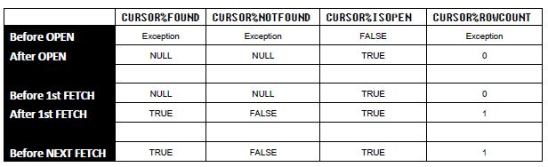
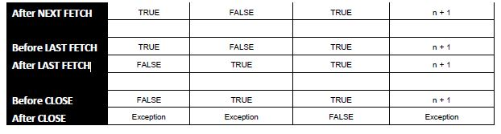
Explicit Cursors: Attributes

Slide 22
Explicit Cursors: WHILE Loop
Declare
CURSOR c_customer IS
SELECT cust_id, cust_name FROM customer;
v_cust_id customer.cust_id%type;
v_cust_name customer.cust_name%type;
BEGIN
OPEN c_customer;
FETCH c_customer INTO v_cust_id, v_cust_name;
WHILE c_customer %FOUND AND c_customer%rowcount <=5
Loop
DBMS_OUTPUT.PUT_LINE
(v_cust_id || ', ' || v_cust_name);
FETCH c_customer INTO v_cust_id, v_cust_name;
END LOOP;
CLOSE c_customer;
END;
Notes:
Fetch is specified before the loop, because while loop will check the condition based on the value of the cursor attribute %FOUND
%FOUND will yield NULL if no fetch is done
So Fetch the value first and then go for WHILE LOOP condition checking.
Since now the condition is satisfied, the loop is entered. If no row is fetched, control will not go within the loop.
Inside the loop, we have to declare one more fetch statement, as we want to fetch the next rows

Slide 23
Explicit Cursor: FOR Loops
LOOP … END LOOP as well as WHILE LOOP … END LOOP, require explicit processing of the cursor with OPEN, FETCH and CLOSE statements
With CURSOR FOR LOOPs, no opening, fetching, closing of Cursors is required
Implicitly declares Record Type Variable

Slide 24

Cursor FOR Loops: Example
DECLARE
CURSOR service_area_subarea IS
  SELECT Service_area_code, subarea_desc
  FROM Service_area sa, service_Subarea ssa
  WHERE sa.Service_area_code = ssa.area_code;
BEGIN
FOR v_rec IN service_area_subarea
/* The loop variable v_rec is automatically declared and is
allocated the same data type as the ROWTYPE of the cursor */
LOOP
DBMS_OUTPUT.PUT_LINE('Service Area Code:' ||
v_rec.Service_area_code);
DBMS_OUTPUT.PUT_LINE('Subarea desc' || v_rec.subarea_desc);
END LOOP;
END;
v_rec is a record type variable
It is implicitly declared
Scope is within the For loop only

Slide 25
Parameterized Cursors
Parameterized cursor allow different values to be passed to a cursor when it is opened and to be used in the query when it executes
Different active set is generated each time based on a parameter value that is passed to a cursor
CURSOR cursor_name
( para_name1 datatype,
para_name2 datatype,… )
IS select_statement;
Notes:
You are probably familiar with parameters for procedures and functions. Parameters provide a way to pass information into and out of a module. If used properly, parameters improve the usefulness and flexibility of modules.
PL/SQL also allows you to pass parameters into cursors.
If you are going to use the cursor in more than one place, with different values for the same WHERE clause, then you should create a parameterized cursor.
A parameter makes the cursor more reusable. Instead of hardcoding a value into the WHERE clause of a query to select particular information, you can use a parameter and then pass different values to the WHERE clause each time a cursor is opened.
You can specify as many cursor parameters as you want and need. When you OPEN the parameter, you need to pass arguments for parameters

Slide 26
Parameterized Cursors: Example
DECLARE
CURSOR par_cur( p_status VARCHAR2) IS
SELECT sr_id FROM service_request
WHERE upper(status)=upper(p_status);
v_status service_request.status%TYPE := '&status';
BEGIN
FOR sr_record IN par_cur(v_status )
LOOP
DBMS_OUTPUT.PUT_LINE ('Srid: ' || sr_record.sr_id );
END LOOP;
END;

Slide 27
SELECT FOR UPDATE in Cursors
When a SELECT statement is issued against the database to query some records, no locks are placed on the selected rows.
At times, lock is required on a set of records even before they are changed in the program. Oracle offers the FOR UPDATE clause of the SELECT statement to perform this locking.
On issuing a SELECT...FOR UPDATE statement, the RDBMS automatically obtains exclusive row-level locks on all the rows identified by the SELECT statement, holding the records "for your changes only" as you move through the rows retrieved by the cursor.
No one else will be able to change any of these records until you perform a ROLLBACK or a COMMIT.

Slide 28
FOR UPDATE clause
  Syntax:
    CURSOR cursor_name IS
    SELECT……FROM…
    FOR UPDATE [OF column_reference] [NOWAIT|WAIT n]
    NOWAIT: OPEN will return immediately with Oracle error if rows are locked by another session
    WAIT n: If rows are locked by another session and are not released in “n” seconds then OPEN will return with Oracle error
  Example:
    CURSOR cust_cursor IS
    SELECT cust_id,cust_name,cust_address
    FROM customer
    WHERE cust_id=501
    FOR UPDATE OF cust_contact NOWAIT;
Notes:
Note:- Normally, a SELECT operation will not take any locks on the rows being accessed. This allows other sessions connected to the database to change the data being selected.The result set is still consistent. At the time of Opening a cursor, when the active set is determined , Oracle takes a snapshot of the table. Any changes that have been committed prior to this point are reflected in the active set. Any changes made after this point, even if committed are not reflected unless the cursor is reopened which will evaluate the active set again. This is the read consistency process

Slide 29
WHERE CURRENT OF Clause
  Used for referencing the current row from an explicit cursor
  Used along with UPDATE & DELETE Statements for current row
  Must include FOR UPDATE clause while declaring a cursor
Notes:
The OF list of the FOR UPDATE clause does not restrict you to changing only those columns listed. Locks are still placed on all rows; the OF list just gives you a way to document more clearly what you intend to change. If you simply state FOR UPDATE in the query and do not include one or more columns after the OF keyword, then the database will then lock all identified rows across all tables listed in the FROM clause.
Eg. # 1
DECLARE
CURSOR emp_cursor IS
SELECT sal FROM emp WHERE deptno=30
FOR UPDATE OF sal NOWAIT;
BEGIN
FOR emp_record IN emp_cursor
LOOP
UPDATE emp
SET sal=emp_record.sal*0.1
WHERE CURRENT OF emp_cursor;
END LOOP;
COMMIT;
END;

Slide 30
WHERE CURRENT OF Clause
UPDATE and DELETE statements can use WHERE CURRENT OF clause if they reference a cursor declared with FOR UPDATE clause.
It indicates that the UPDATE or DELETE should modify the current row identified by the FOR UPDATE cursor.
Syntax:
[UPDATE | DELETE ] ... WHERE CURRENT OF cursor_name;
Using WHERE CURRENT OF clause, avoid repetition of the WHERE clause in the UPDATE/DELETE statement.
Notes:
The most important advantage to using WHERE CURRENT OF where you need to change the row fetched last is that you do not have to code in two (or more) places the criteria used to uniquely identify a row in a table.
It would be so much more convenient and natural to be able to code the equivalent of the following statements:
Delete the record I just fetched.
or
Update these columns in that row I just fetched.

Slide 31
WHERE CURRENT OF Clause: Example
CREATE TABLE cust_history(
mycust NUMBER(4),
mycustname VARCHAR2(20),
mycustadress VARCHAR2(30));
DECLARE
  CURSOR cust_cursor IS
  SELECT cust_id,cust_name,cust_address
  FROM customer
  WHERE cust_id=501 FOR UPDATE;
BEGIN
FOR cust_rec IN cust_cursor
LOOP
INSERT INTO cust_history VALUES
(cust_rec.cust_id, cust_rec.cust_name,cust_rec.address);
DELETE FROM customer WHERE CURRENT OF cust_cursor;
END LOOP;
END;

Slide 32
REF Cursors

Slide 33
REF Cursors
Reference cursors basically provide a gateway to a set of data which has been previously filtered and extracted into memory.
They are a powerful method of manipulating data items.
Notes:
Oracle cursors allow the developer to decide how and when data items are retrieved.
The type and use of cursor depends on the data and the business logic.

Slide 34
REF Cursor Or Cursor Variable
Cursor object:
    The result set identified by the cursor SQL statement. Its like constant
REF Cursor / Cursor Variable
    Nothing more than a reference or pointer.
PL/SQL Program
Cursor variable
Shared global area of database
Cursor object
Query Result Set
Notes:
It is very important to distinguish between declaring a cursor variable and creating an actual cursor object -- the result set identified by the cursor SQL statement. The cursor variable is nothing more than a reference or pointer. A constant is nothing more than a value, whereas a variable points to its value. Similarly, a static cursor acts as a constant, whereas a cursor variable points to a cursor object. These distinctions are shown in Figure.
Notice that two different cursor variables in different programs both refer to the same cursor object.

Slide 35
REF Cursor Or Cursor Variable
A REF Cursor variable is not a cursor, but a variable that points to a cursor result
The ref cursor is a "pointer" datatype that allows you to quickly reference any cursor result (usually an internal PL/SQL table array) with data values kept in RAM.
A variable created based on such a data type is generally called a cursor variable.
A cursor variable can be associated with different queries at run-time.
Notes:
The ref cursor is a "pointer" data types that allows you to quickly reference any cursor result (usually an internal PL/SQL table array) with data values kept in super-fast RAM.
a ref cursor variable is not a cursor, but a variable that points to a cursor

Slide 36
Difference between Cursor & REF Cursor
Unlike an explicit cursor, which names the PL/SQL work area for the result set, a cursor variable is a reference to that work area
Unlike an explicit cursor, which always refers to the same query work area, a cursor variable can refer to different work areas.
You cannot use a cursor variable where a cursor is expected, or vice versa.
Notes:
The ref cursor is a "pointer" data types that allows you to quickly reference any cursor result (usually an internal PL/SQL table array) with data values kept in super-fast RAM.
a ref cursor variable is not a cursor, but a variable that points to a cursor
Unlike an explicit cursor, which always refers to the same query work area, a cursor variable can refer to different work areas. You cannot use a cursor variable where a cursor is expected, or vice versa.

Slide 37
Features of REF Cursors
Single cursor variable can be used to fetch from different result sets
Pass a cursor variable as an argument to a procedure or function
Deploy the full functionality of static PL/SQL cursors for cursor variables
Assign the contents of one cursor (and its result set) to another cursor variable
Has capability to pass result sets between sub programs (like stored procedures, functions, packages etc.).
Notes:
The primary advantage of using cursor variables is their capability to pass result sets between sub programs (like stored procedures, functions, packages etc.).

Slide 38
Creating a REF CURSOR type
Syntax
  TYPE cur_type_name IS REF CURSOR
  [ RETURN return_type ];
return-type : The RETURN data specification for the cursor type.
In short, what kind of data will be returned by a cursor

Slide 39
REF Cursors Types
There are 2 basic types:
    Strong ref cursor
    Weak ref cursor

Slide 40
Strong REF Cursors
Cursor type with a RETURN clause; associated with a specific data structure
Eg: TYPE cust_type REF CURSOR
RETURN customer%ROWTYPE;
For strong REF CURSOR type cursor variables, the structure of the SELECT statement must match or be compatible with the structure specified in the RETURN clause of the type statement.
Note : Cursor RETURN type must be %ROWTYPE or RECORD Type.
Notes:
For the strong ref cursor the returning columns with data type and length need to be known at compile time.

Slide 41
STRONG REF CURSOR with %ROWTYPE
DECLARE
TYPE ref_cursor is REF CURSOR RETURN customer%ROWTYPE;
c_cust ref_cursor;
v_cust customer%ROWTYPE;
BEGIN
OPEN c_cust FOR SELECT * FROM customer;
LOOP
FETCH c_cust INTO v_cust;
EXIT WHEN c_cust%NOTFOUND;
DBMS_OUTPUT.PUT_LINE
(v_cust.cust_name || ' - ' || v_cust.cust_address);
END LOOP;
CLOSE c_cust;
END;
Notes:
Retrieve more than one column (or entire row) of information using REF Cursors
Let Us consider the above example:
The only crucial declaration is the following:
v_cust cust%ROWTYPE;
The above declares a variable named “v_cust" which can hold an entire row from the "cust" table.

Slide 42
STRONG REF Cursor with RECORD Type
DECLARE
TYPE rec_name IS RECORD
( name customer.cust_name%TYPE );
TYPE ref_cursor IS REF CURSOR RETURN rec_name;
c_cust ref_cursor;
v_name customer.cust_name%type;
BEGIN
OPEN c_cust FOR SELECT cust_name FROM customer;
LOOP
FETCH c_cust INTO v_name;
EXIT WHEN c_cust%NOTFOUND;
DBMS_OUTPUT.PUT_LINE (v_name);
END LOOP;
CLOSE c_cust;
END;
Notes:
The following is the first statement you need to understand:
TYPE ref_cursor IS REF CURSOR RETURN rec_ename;
The above statement simply defines a new data type called "ref_cursor," which is of the type REF CURSOR.
Note : Cursor RETURN type must be %ROWTYPE or RECORD Type.
We declare a cursor variable named "c_cust" based on the type "ref_cursor" as follows:
c_cust ref_cursor;
Every cursor variable must be opened with an associated SELECT statement as follows:
OPEN c_cust FOR SELECT ename FROM cust;
To retrieve each row of information from the cursor, used a loop together with a FETCH statement as follows:
LOOP
FETCH c_cust INTO v_name;
EXIT WHEN c_cust%NOTFOUND;
DBMS_OUTPUT.PUT_LINE (v_name);
END LOOP;
Closed the cursor using the following statement:
CLOSE c_cust;

Slide 43
Working with more than one query
A REF CURSOR can be associated with more than one SELECT statement at run-time.
Before associating a new SELECT statement, we need to close the CURSOR.

Slide 44
Weak REF Cursors
A REF Cursor type without a RETURN clause; not associated with a specific data structure.
Eg: TYPE cust_type REF CURSOR;
For the weak ref cursor the structure does not need to be known at compile time.

Slide 45
WEAK REF Cursor
DECLARE
TYPE ref_cursor is REF CURSOR;
cur_fetch ref_cursor;
v_sr Service_Request%ROWTYPE;
v_cust customer%ROWTYPE;
BEGIN
OPEN cur_fetch FOR SELECT * FROM customer;
LOOP
FETCH cur_fetch INTO v_cust;
EXIT WHEN cur_fetch%NOTFOUND;
DBMS_OUTPUT.PUT_LINE
(v_cust.cust_name || ' - ' || v_cust.cust_contact);
END LOOP;
CLOSE cur_fetch;
Notes:
DECLARE
TYPE ref_cursor is REF CURSOR;
cur_fetch ref_cursor;
v_sr Service_Request%ROWTYPE;
v_cust customer%ROWTYPE;
BEGIN
OPEN cur_fetch FOR SELECT * FROM customer;
LOOP
FETCH cur_fetch INTO v_cust;
EXIT WHEN cur_fetch%NOTFOUND;
DBMS_OUTPUT.PUT_LINE (v_cust.cust_name || ' - ' || v_cust.cust_contact);
END LOOP;
CLOSE cur_fetch;
OPEN cur_fetch FOR SELECT * FROM Service_Request;
LOOP
FETCH cur_fetch INTO v_sr;
EXIT WHEN cur_fetch%NOTFOUND;
DBMS_OUTPUT.PUT_LINE (v_sr.sr_id || ' - ' || v_sr.status|| ' : ' || v_sr.comments);
END LOOP;
CLOSE cur_fetch;
END;
/

Slide 46
WEAK REF Cursor
OPEN cur_fetch FOR SELECT * FROM Service_Request;
LOOP
FETCH cur_fetch INTO v_sr;
EXIT WHEN cur_fetch%NOTFOUND;
DBMS_OUTPUT.PUT_LINE (v_sr.sr_id || ' - ' || v_sr.status|| ' : ' || v_sr.comments);
END LOOP;
CLOSE cur_fetch;
END;
Notes:
DECLARE
TYPE ref_cursor is REF CURSOR;
cur_fetch ref_cursor;
v_sr Service_Request%ROWTYPE;
v_cust customer%ROWTYPE;
BEGIN
OPEN cur_fetch FOR SELECT * FROM customer;
LOOP
FETCH cur_fetch INTO v_cust;
EXIT WHEN cur_fetch%NOTFOUND;
DBMS_OUTPUT.PUT_LINE (v_cust.cust_name || ' - ' || v_cust.cust_contact);
END LOOP;
CLOSE cur_fetch;
OPEN cur_fetch FOR SELECT * FROM Service_Request;
LOOP
FETCH cur_fetch INTO v_sr;
EXIT WHEN cur_fetch%NOTFOUND;
DBMS_OUTPUT.PUT_LINE (v_sr.sr_id || ' - ' || v_sr.status|| ' : ' || v_sr.comments);
END LOOP;
CLOSE cur_fetch;
END;
/

Slide 47
Few Points to remember
Cursor variable is a reference to a cursor object or query in the database. It is not the object itself.
Unlike Cursors, the cursor variable can be assigned the value of an already OPENed host cursor variable or PL/SQL cursor variable.
Comparison operators can be used to test cursor variables for equality, inequality, or nullity.
A cursor variable cannot be referenced in a cursor FOR loop.

Slide 48
Good Coding Practices

Slide 49
Good Coding Practice
Use of Explicit cursors for fetching data from a table
    Faster
    Exception Handling is easier
    Greater programmatic control
Use Cursor FOR LOOP
    No need to write OPEN, FETCH and CLOSE
    Results in lesser Lines of Code & Errors

Slide 50
Good Coding Practice
Fetch into Cursor Records
name VARCHAR2 (30);
minbal NUMBER(10,2);
BEGIN
OPEN company_pkg.allrows;
FETCH company_pkg.allrows
INTO name, minbal;
IF name = ‘ACME’ THEN ...
CLOSE company_pkg.allrows;
Fetching into individual
variables hard-codes
number of items in select
list.
rec company_pkg.allrows%ROWTYPE;
BEGIN
OPEN company_pkg.allrows;
FETCH company_pkg.allrows INTO rec;
IF rec.name = ‘ACME’ THEN ...
CLOSE company_pkg.allrows;
If the cursor select list
changes, it doesn't
necessarily affect your code

Slide 51
Summary
In this session, we have discussed:
Implicit Cursors
Explicit Cursors
Cursors FOR LOOPS
Parameterized Cursors
Using FOR UPDATE clause and WHERE CURRENT OF clause with cursors
REF Cursors, its features and types
Strong Cursors
Weak Cursors
Using REF Cursors for Multiple Queries

Slide 52
Thank You

